Slide 1

Strategic Information Systems Management Section 1 Communicating with business managers Class Code: COMP423 H.Y Kan, Stanley Room: (WUI CHI) - 4/F, N46B Email: hykan@ipm.edu.mo Tel: 8599-6883

Slide 2
Introduction
At an IT Governance meeting, attended by all our business executives, our IT architect was asked to discuss IT security and what steps needed to be taken to improve it. The architect proceeded to bombard the executives with extremely low-level details – an oversaturation of information, which they did not understand - and he lost their attention in very short order. What he did not do was deliver information in a positive manner geared to his audience. As a result, there was diminished business interest and understanding about this topic and a slowed-down budget for needed upgrades, which also affects other projects.
- Senior IT manager in a global retail organization

Slide 3
Introduction (Cont’d)
As IT and business grow more entwined, IT staff are going to need to be increasingly organization and possess greater business and interpersonal competencies.
However, IT departments tend to hire largely for technical competencies and have little budget available for “soft skills” development.
IT managers often forget the fact that IT-based initiatives – for example, to implement new technologies or establish a standard infrastructure - which they believe could have significant benefits for their organizations are not funded.
Many of the reasons just because of the IT’s inability to explain the value of such investments in terms of the business will understand.

Slide 4
Communication in the Business-IT Relationship
IT personnel are perceived to live in an “ivory tower,” disengaged from the needs of the business. This communication or cultural “gap” between business and IT is considered a major cause of systems development failures.
Good communication is important:
It is fundamental to building a strong, positive business-IT relationship.
It helps set sensible expectations of IT and helps IT to manage how it is perceived in business.
It is an essential element of building trust and partnership, which in turn help drive the delivery of business value.
It is essential to conveying the business value of IT
It is critical to understand the priorities and pressures of the business
In short, good communication is widely seen as being critical for IT to deliver successful projects, effective performance, and value.

Slide 5
Communication

Slide 6
What is Good Communication?
Principle 1: The effectiveness of communication is measured by its outcome.
One study showed that although 97% of managers believed their own communication was clear, only 25% of the same people believed that the communication they received from their direct superior was clear and effective.
Another study showed that IT managers feel their communication is more effective than business managers feel it is.
Principle 2: Communication is a social behavior.
Communication not only transmits ideas; it also negotiates relationships.
Thus, how you say what you mean is just as important as what you say.

Slide 7
What is Good Communication? (Cont’d)
Shared Knowledge
Principle 3: Shared knowledge improve communications.
Studies show that the more IT staff learns about the business, the better communication becomes.
Shared knowledge leads to increased frequency of communication and greater understanding, both of which lead to more success in implementation, which in turn leads to more communication and improve relationships.
Increased Communication
Implementation Success
Mutual Understanding and “Common Sense”

Slide 8
What is Good Communication? (Cont’d)
Principle 4: Matured organizations have better communication.
Although communication is a social process, it is also embedded within and fundamental to organization processes.
Strong practices support and reinforce good interpersonal communication.
“You can’t be a partner unless you’re a mature IT organization.”
Improved maturity can help communication in terms of:
Developing business cases
Risk assessments
Integrating with the “big picture”
Communicating across business silos

Slide 9
Obstacles to Effective Communication
The changing nature of IT work: Increasingly, IT staff are intermediaries between third party contract staff, global staff, or external stakeholders and vendors as well as traditional business users. When multiple cultures, different political contexts, diverse time zones and virtual relationships are added into the mix, communication simply becomes more multifaceted and challenging. Furthermore, transformation, innovation or simply bigger and more visible projects all require more communication than the norm.
Hiring practices: IT skills are changing to become more consultative and collaborative. “IT organizations can no longer support smart, super-talented but socially disruptive people who cannot work well with a team or with the business.” However, advertised job requirements tend emphasize formal technical training.

Slide 10
Obstacles to Effective Communication (Cont’d)
IT and business organization structures: Many IT functions have attempted to deal with their communication problems by creating relationship managers, who are skilled IT individuals that act as a bridge between business and IT. However, this arrangement can limit the development of shared knowledge and mutual understanding because the relationship managers often become the only contact through which business can reach IT.
Nature and frequency of communication: More frequent contact with business leads to improved communication, but IT’s communication is often so full of jargon, technocentric and inappropriate that many organizations have sought ways to limit the amount and nature of communication between the two groups. One study found that about one-third of IT staff simply did not speak to the business at all.
Attitude: “Our IT staff think their work is about IT. They don’t understand that we’re here to deliver business value with technology.” Many IT staff are motivated by the desire to be right rather than the desire to communicate effectively.

Slide 11
Communication Skills for IT Staff
As the business becomes more complex, it needs more people who are deep problem solvers in their home discipline but also capable of interacting and understanding others from a wide range of disciplines and functional areas.
Communication skills required in cross-disciplinary collaboration:
Translation
Tailoring
Transparency
Thinking, talking and listening

Slide 12
Communication Skills for IT Staff (Cont’d)
Translation requires the ability to understand how IT initiatives will affect the business or deliver value to it.
IT managers must translate operational performance to business performance and understand that IT initiatives are business initiatives
Business Impact of Technology Issues
Business Solutions
Technology Issues
IT Solutions
Business
IT
Translation
Translation

Slide 13
Communication Skills for IT Staff (Cont’d)
Tailoring: IT staff needs to adapt their communication to the needs of their audience. This involve two skills. First, IT workers need to know their audience - understanding their needs, their agendas, and their politics – so that they communicate in ways the business needs and wants to hear. Second, all IT personnel need to know how to choose communication methods appropriately, e.g., bad news is best delivered in face-to-face meetings, not in reports or emails.
Transparency is a cornerstone of trust in the business-IT relationship. The business needs to know what is done in IT and what it costs. Ways to promote transparent communication include checking assumptions, clarifying goals, stating intentions up front and asking for feedback on understanding.
Thinking, talking and listening: IT staff need to think horizontally across the enterprise in order to do what is best for the business. Communicating innovative ideas effectively involve “getting inside the head of the business.” IT managers should think and talk like a business person with a strong background in technology. Thinking also means understanding how and where to speak and how to listen to others.

Slide 14
Improving Business-IT Communication
Practices that would promote the development of good communication skills among their staff:
Make the importance of effective communication visible
Work with HR to develop new skills expectation and roles
Develop communication skills both formally and informally
Increase the nature and frequency of communication
Spend more time on communication

Slide 15
Improving Business-IT Communication (Cont’d)
Make the importance of effective communication visible: It is well-accepted that if you want people to pay attention to something, you need to measure and incentivize for it. A effective way to get staff to pay attention is to incorporate communication skills into performance appraisals.
Work with HR to develop new skills expectation and roles: Some firms are incorporating specific communication competencies into staff role descriptions. Some even use job titles which reflect the types of competencies needed such as “senior business consultant,” “technology relationship manager” and “business technology specialist.”
Develop communication skills both formally and informally: Some firms offer formal training in communication skills in areas such as making presentations, communication styles and negotiations. More informal approaches include mentoring, lunch-and-learn sessions, and self-assessment tools.

Slide 16
Improving Business-IT Communication (Cont’d)
Increase the nature and frequency of communication: Create a “virtuous communication cycle” by creating shared knowledge. Priority should be given to informal communication and social interaction as these are the best ways to build up shared language and understanding. This is particularly important when face-to-face communication is irregular or impossible.
Spend more time on communication: IT leaders at all levels need to spend more time on communication, not only in what and how they communicate personally but rather in learning how their staff and organizations communicate.

Slide 17
IT Communications Competencies
Level 1: Listens and clearly presents information
Listens/pays attention actively and objectively (Persons with hearing impairments may lip-read.)
Presents information and facts in a logical manner, using appropriate phrasing and vocabulary
Shared information willingly and on a timely basis
Communicates with others honestly, respectfully, sensitively
Recognizes and uses nonverbal communications

Slide 18
IT Communications Competencies (Cont’d)
Level 2: Fosters two-way communication
Recalls others’ main points and takes them into account in own communication
Checks own understanding of others’ communication (e.g., paraphrases, ask questions)
Elicit comments or feedback on what has been said
Maintains continuous, open, and consistent communication with others, considering nonverbal messaging as required

Slide 19
IT Communications Competencies (Cont’d)
Level 3: Adapts communication
Tailors communication (e.g., content, style and medium) to diverse audiences
Reads cues from diverse listeners to assess when and how to change planned communication approach to effectively deliver message
Communicates equally effectively with all organizational levels and sells ideas and concepts
Understands others’ complex or underlying needs, motivations, emotions, or concerns and communicates effectively despite sensitivity of the situation

Slide 20
IT Communications Competencies (Cont’d)
Level 4: Communicates complex messages
Communicates complex issues clearly and credibly with widely varied audiences
Handles difficult on-the-spot questions (i.e., from senior executives, public officials, interest groups, or the media)
Reads nonverbal communications signs and adapts materials and approach as required
Overcomes resistance and secures support for ideas or initiatives through high-impact communication

Slide 21
IT Communications Competencies (Cont’d)
Level 5: Communicates strategically
Scans the environment for key information and messages to form the development of communication strategies
Communicates strategically to achieve specific objectives (e.g., considers optimal “messaging” and timing of communication)
Uses varied communication vehicles and opportunities to promote dialogue and develop shared understanding and consensus

Slide 22
The Development of Strategic Management

Slide 23
The Development of Strategic Management
Strategy refers to a long-term action plan for achieving the stated aims of an organization.
Strategic management is expressed from a “top-down” perspective of the decisions of managers in an organizations.
It involves setting the goals of the organization, choosing the most appropriate actions for achieving aims, and fulfilling the aims over a set of timeframe.
Managers involved in formulating a strategy undertake a series of decisions and actions designed to achieve stated aims based on an analysis of their internal and external environments.
Strategic management is by its very nature iterative and therefore involves a process of feedback and learning as a means of informing future actions.

Slide 24
The Development of Strategic Management (Cont’d)
Peter Drucker (1954) developed the concept of management by objectives (MBO). He recognized the value of intellectual capital in organizations, and the role of “knowledge workers” in the success of firms.
Philip Selznick (1957) developed the first model to match internal and external factors as basis for analyzing the strengths and weaknesses of firms.
Schumpeter (1934) developed the theoretical perspectives on new value creation through technological change and innovation. Sources of innovation included new products, new means of production, new markets, new sources of supply and the reorganization of industries. The concept of “creative destruction” was arguably Schumpeter’s most significant contribution.
“Schumpeterian rents” - arose from risk taking activities by knowledge entrepreneurs in a rapidly changing, uncertain and complex environment.

Slide 25
The Development of Strategic Management (Cont’d)
The Structure-Conduct-Performance Paradigm (Mason in 1930s, Bain 1959, Scherer 1980):
Performance was dependent upon the conduct displayed by buyers and sellers in any given market based on a range of criteria such as prices, investment, advertising, technological development, firm collaboration and so on.
In turn, conduct was dependent on the structure of each given market defined by the number and size distribution of sellers and buyers, the degree of product differentiation, entry barriers, cost structures, integration and diversification.
Structure
Conduct
Performance

Slide 26
The Development of Strategic Management (Cont’d)
In time, the linear relationship between the three elements in the S-C-P model was challenged and the dominance of the paradigm gave way to the Positioning Approach, commonly associated with the Harvard School.
SWOT, five-forces model, value-chain model
However, the Chicago School views two key elements of the Positioning Approach differently.
The Harvard School views entry barriers and industry concentration as a means of securing above average industry profits; whereas the Chicago School view entry barriers as informational and concentration because of efficiency.
In essence, the Chicago School views superior performance as stemming from the better use of underlying assets deployed by a firm rather than the exercising of economic power by restricting supply. This thinking can be seen in the development of the Resource-Based View (RBV) of the firm that was destined to dominate the 1990s and beyond.

Slide 27
The Development of Strategic Management (Cont’d)
The Internet provides an effective medium for information gathering, storage and use and many firms have based their business models around the applications of this medium of communication. This gave rise to the concept of the virtual value chain.
While the Internet can be used to share information among key stakeholders such as suppliers and customers, unlike physical goods it does not diminish through use.
Where the physical value chain acts as a support mechanism, the virtual value chain has a strategic function.
Porter’s original model was designed with a manufacturing company in mind but he latter revised the concept to offer an account of the influence of the Internet in driving added value (Porter 2001).

Slide 28
The Development of Strategic Management (Cont’d)
The RBV emphasizes intangible resources and the generation and sharing of knowledge as a resource. Consequently, the RBV overlaps the Knowledge-Based View (KBV).
KBV emphasizes knowledge as the key resource in organizations. Competitive advantage is derived from the superior use and integration of tacit knowledge, rather than the explicit knowledge.
Information technology plays a key role in the formation of the KBV as it aids the gathering, storage, use and dissemination of knowledge both throughout the organization and to external partners.

Slide 29
The Development of Strategic Management (Cont’d)
Teece et al. (1997) introduced the concept of “dynamic capabilities.” These capabilities refer to the ability to integrate, build and reconfigure internal and external competencies with competitive environment characterized by rapid change.
The dynamic capabilities theory allows the fluid dimension that is lacking in the RBV by focusing attention on how resources can be developed and integrated into the firm and then released as a means of creating a competitive advantage.

Slide 30
The Development of Strategic Management (Cont’d)
 | 1950s | 1960s/early 1970s | Late 1970s/ 1980s | Late 1980s/ 1990s | 2000s
Dominant Approach | Business case studies | Corporate-level planning | Positioning Approach | Resource-Based View | Dynamic capabilities
Themes | Planning and controlling | Company growth | Industry and market selection | Competitive advantage | Innovation, creativity, change
Key Issues | Budgets and control mechanisms | Diversification and mergers/ acquisitions | Strategies for industry leadership | Building new capabilities | Agility, opportunistic, speed
Techniques | Operating systems, forecasting S-C-P | Forecasting, Identify synergies | Five Forces, SWOT, Value Chain | Knowledge management, IT/IS, learning | Collaboration, knowledge management
Organization Effects | Controlled, hierarchical | Planning departments | Divisional, multinational | Re-engineering, restructuring, outsourcing | Global networks, flat structures

Slide 31
The development of the Digital Economy

Slide 32
The Development of the Digital Economy
Technological advances have changed the lives of people around the globe and how business is conducted.
The most significant event driving this change for the development of the World Wide Web in the mid 1990s. It has allowed previously disjointed computer systems to link up on a global scale and ensured the commercial viability of the Internet as a medium of communication.
While e-commerce is concerned with buy-side and sell-side transactions, e-business extends to incorporate electronic marketing, procurement, customer service, distribution, transactions fulfilment and the automation of business processes.

Slide 33
The Development of the Digital Economy (Cont’d)
The Internet have played a key role in transforming business by providing the means to increase efficiency, speed and quality of delivering products and services to customers. Some of the key attributes include:
increasing efficiency in the process of transactions between buyers and sellers;
giving customers access to information on prices, availability, discounts, delivery times, sales policies and promotional material;
increasing collaboration between partners along the supply chain;
offering constant availability so that transactions can occur at any time in the connected world;
the removal of traditional boundaries in organizations such as time and distance;
the automation of internal processes to increase efficiency and speed;
and the building of more in-depth and longer-lasting relationships with customers through personalization and customization of products and services

Slide 34
The Development of the Digital Economy (Cont’d)
Organizational structures have evolved from being hierarchical to networked or virtual. Many employees work remotely from the centres of business and use technology as a means of communication, collaboration and coordination in their working lives.
Growth is highly dependent on innovation, knowledge and creativity as firms seek to continually add value to customers.
Another effect of the digital revolution has been the evident convergence of industries and technologies, e.g., telecommunications, broadcasting and computing.
More and more market share is being vested in fewer firms, e.g., Google.
The key factors that can determine competitive advantage in the digital economy involve firms being flexible, opportunistic, quick to market, collaborative and specialized in their niche.

Slide 35
The Positioning Approach
The generic strategy model: applicable to many firms
The five forces model: applicable to many firms; focuses on competitiveness and external factors.
The value chain model: has an internal focus and can be applied to individual firms

Slide 36
The Positioning Approach

Slide 37
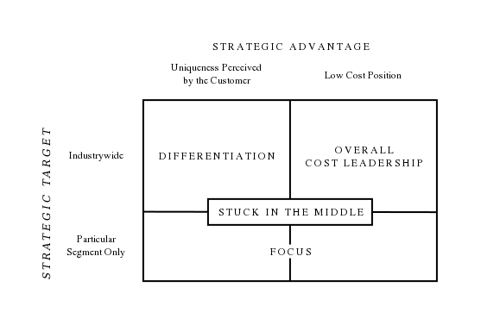
The Positioning Approach
Generic Strategies for E-Business
Developed by Porter (1980) to help firms overcome the constraints that emerge from external environments.
Features strategies of cost leadership, differentiation and focus, each can help firms achieve a competitive advantage.
Source: Wikipedia.com

Slide 38
The Positioning Approach (Cont’d)
Generic Strategies for E-Business (Cont’d)
Cost leadership refers to firms who are able to produce and sell products or services at lower cost compared to rivals.
Competition is intense in the digital economy, so scope for reducing product cost is limited. More likely is the opportunity for lowering transaction costs, e.g., information-based logistics.
Differentiation is a strategy for competitive advantage based on a firm’s ability to make the product or service different from that produced by rivals.
Some prominent means of differentiating in the digital economy includes creating a strong brand and reputation; offering high quality website with ease of navigation and quick transactions and fulfilment; creating effective marketing campaigns; offering customized and personalized products and services; and offering delivery times better than rivals as part of a superior customer service.

Slide 39
The Positioning Approach (Cont’d)
Generic Strategies for E-Business (Cont’d)
A focus strategy is the choice of market segment that firms aim their products or service at. The choice may entail a narrow focus, whereby the scope of the market segment is detailed and clearly identified, or a broad focus where the scope of the market is defined by a group of segments.
Firms may target a particular group of customers with distinct profiles based on age, incomes, geographical location, tastes, interests, and gender.
Personalization and customization may be features of this strategy as specialist knowledge of a market segment helps firms design and produce products and services to match the needs of the target individual or group.
There are also cost benefits to be gained by targeting a small number of target groups rather than spreading resources more thinly across a large number of market segments or even the whole market.

Slide 40
Class Exercise
The Generic Strategy Model

Slide 41
The Positioning Approach (Cont’d)
E-Business Value Chain
Business activities and transactions that are undertaken via fixed or wireless infrastructure and add value are referred to as the virtual value chain.
The virtual value chain differs from the traditional value chain as it is not limited by organizational boundaries such as time and distance.
Information is the resource that firms use to add value by creating linkages between suppliers, partners and customers.
Porter (1985) proposed the value chain model as a means of identifying those activities that form the basis of a firm’s strategy for achieving competitive advantage by driving down costs or differentiating the product or service.

Slide 42
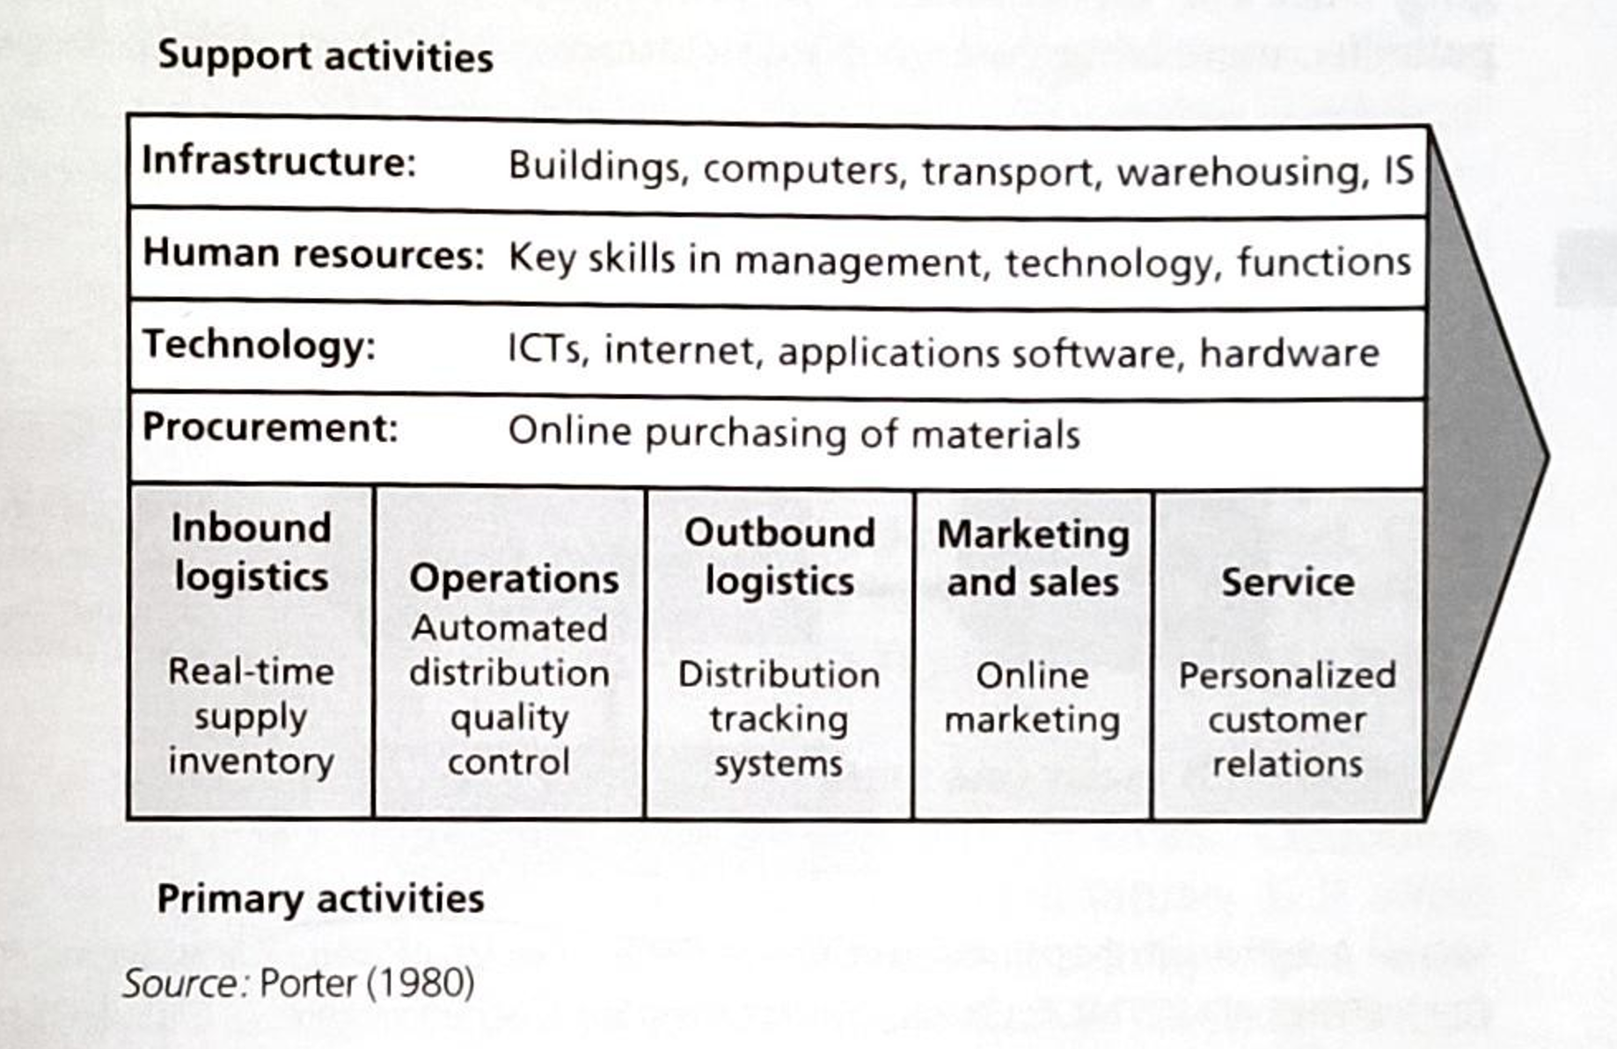
The Positioning Approach (Cont’d)
E-Business Value Chain (Cont’d)
The four key steps to value chain analysis include:
The definition of the strategic business unit under analysis
The identification of key activities
The definition of products or services
The determination of the value attached to each identified
Porter’s definition of value is determined by the amount buyers are willing to pay for a product or service.
Added value is measured by the total revenue after the cost of product has been met.
For example, one way FedEx succeeded in achieving competitive advantage was to develop and implement software that allowed customers to track the progress of their packages from sender to destination.

Slide 43
Class Exercise
The Value Chain Model

Slide 44
The Competitive Environment

Slide 45
The Competitive Environment
The five forces model is an important tool for analyzing how the competitive forces affect the industry affect the average profits of industry competitors.
Each force has an effect of the firm’s ability to compete in the industry.
Analysis from the five forces model informs strategy managers whether to stay in the industry and where best to deploy their resources.
How does the Internet affect each of the five forces in the model?
Rivalry among Existing Firms
Threat of New Substitutes
Bargaining Power of Buyers
Threat of New Entrants
Bargaining Power of Suppliers

Slide 46
The Competitive Environment (Cont’d)
The e-business competitive environment is characterized by a large number of competitors as costs associated with entry are relative low. However, new entrants must provide a product or service that adds value to the consumers above that which is already provided by the incumbents.
Firms can create entry barriers to reduce the threat of potential entrants. These include switching costs, economies of scale and access to distribution channels.
There may be greater risks involved when firms promote and sell products online but are required to deliver the physical product to the customers. Consumers have greater expectations regarding delivery times in the online environment. Firms who have established relationships with key distributors can create a barrier to entry for potential rivals.
Ease of entry may attract competitors and raises the likelihood of substitute products and services being made available by rivals.
The Internet empowers customers by allowing access to market information.

Slide 47
The Competitive Environment (Cont’d)
Suppliers can increase their bargaining power by differentiating their products or services. Technology can be used as a means of improving logistics, procurement and delivery times. However, increased bargaining power through differentiation is usually short lived for most firms as rivals will quickly imitate the successful differentiating service and erode any competitive advantage.
Porter views the Internet as a means for supporting a distinctive strategy rather than a source of competitive advantage in itself.
Porter’s models however lack a dynamic dimension capable of accounting for rapid change in a fast evolving industry.
In addition, Porter’s model is based on an assumption that all firms engage in intense rivalry. In fact, the new economy is characterized by strategic alliances, partnerships and collaboration between firms along the supply chains of industries.

Slide 48
Class Exercise
The Five Forces Model

Slide 49
The Resources-Based View

Slide 50
The Resource-Based View (RBV)
Grant et al. (2010) consider the resource-based view to be a more appropriate framework for understanding strategies in the digital world.
The resource-based view is more internal focused.
Internal analysis is undertaken by examining firm-specific resources and the capabilities that are developed within the firm that allow it to compete in the industry sector.
IT-specific tangible resources can include financial (cash flow, borrowings, equity); physical (hardware, software, computers); technological (IS/IT applications) or organizational (processes, control systems) resources.
Intangible resources include human (IT expertise, skills, experience, knowledge); innovation (creativity, innovative ideas, technical aptitude); and reputational (quality, service, reliability, trust) resources.
Organizational capabilities are determine by the firm’s ability to leverage advantage from combining both tangible and intangible resources.
Barney (1991) argues that gaining competitive advantage through superior performance requires resources and capabilities to be rare, valuable, non-substitutable and non-imitable.

Slide 51
The Resource-Based View (RBV) (Cont’d)
To sustain a competitive advantage, Barney suggests two conditions under which a firm can use its resources:
Resource heterogeneity refers to a situation where a firm has a different mix of resources as rivals. This may allow the firm to gain a competitive advantage.
Resource inimitability refers to a situation where it is not the resources themselves that create the competitive advantage but rather the unique attributes created from the use to which they are employed. Inimitability refers to the uniqueness of the attributes created by using firm-specific resources.
A criticism by Barney is that the theory is tautological – that is, the assertions made a true by definitions rather than through empirical testing.

Slide 52
Class Exercise
The Resource-Based View

Slide 53
E-Business and the RBV
The IT infrastructure represents business-critical and tangible IS resources that provide the basis for business applications designed to create a competitive advantage.
Byrd and Turner (2000) incorporate IT management as a further component of IT infrastructure thereby brining the framework into the realm of the RBV by recognizing the role of controlling, coordinating and managing IT resources and capabilities in the quest for achieving competitive advantage.
Value can be gained through effective management of business processes in two main ways:
Firstly, through internal business processes along the value chain such as logistics, operations, marketing or service.
Secondly, through business processes that engage with other organizations.
To develop and implement a coherent strategy, e-business resources and capabilities need to be inextricably linked to IT infrastructure capabilities and business process capabilities. IT infrastructure capabilities revolve around technology, while business process capabilities revolve around internal functions across the value chain and inter-organizational processes.

Slide 54
The Strategic Information System and the RBV

Slide 55
Strategic Information Systems and the RBV
Effective contribution to strategic development and implementation requires coherent links between IS strategies and organizational strategies. That is, the IS function has to align firmly to business goals rather than the traditional emphasis on user needs.
Firms need to implement strategies to acquire their information systems infrastructure. This can be done in two main ways:
internally, through the development of their IS function; or
externally, through outsourcing all or part of the delivery of development, maintenance and operation of their systems.
Many firms have been tempted to outsource the IS function as a way to reduce cost and release resources to focus on core activities. IS outsourcing however is unlikely to yield a competitive advantage in itself.
Organizational Strategy
IS Strategy

Slide 56
Dynamic Capabilities

Slide 57
Dynamic Capabilities
Teece et al. (1997) further developed the RBV by introducing the concept of dynamic capabilities.
Dynamic capabilities refer to firm’s capacity to renew existing competencies within a rapidly changing and dynamic environment such as e-business.
Dynamic capabilities can help gain a competitive advantage by reconfiguring current resources, gaining new resources, or making better use of other resources.
Daniel and Wilson (2003) propose a set of dynamic capabilities:
Rapid strategic decision-making
Acceptance of the need for strategic change
Designing the value proposition to the e-business domain
Reconfiguration of the service process

Slide 58
Dynamic Capabilities (Cont’d)
In e-business,
Rapid strategic decision making can be a challenge to strategic managers because in the traditional economy the development of a strategy normally entails a process over a timeframe stretching to months or years. In the e-business, this timeframe can be compressed to weeks leading to increased risk of choosing the wrong or inappropriate strategy or failing to link strategy formulation with implementation in a coherent manner.
The acceptance of the need for strategic change requires identification of key benefits that accrue to each stakeholder group through participation in e-business processes and then to communicate those benefits to each group.
Firms need to find ways of communicating value proposition to them within the specific environment of web-enabled promotion. Whereas traditional businesses rely on the results of market testing and research for information on how customers react to a value proposition, the e-business domain requires quicker response rates.
Customers can take a more proactive role in initiating and continuing dialogue with firms. Real-time, two-way communication between a customer and an e-business may allow the firm to channel specific promotional material to that customer in response to a specific request or as part of a permission marketing strategy.

Slide 59
Dynamic Capabilities (Cont’d)
Key sources of dynamic capabilities:
Marketing sensing
The ability of the firm to analyze and understand the external forces that influence its ability to compete, e.g., competitor intelligence, market research, etc.
Organizational learning
The firm’s ability to gather, store, analyze, synthesize, disseminate and use information effectively and integrate that capability into their strategy, e.g., use of systems such as Enterprise Resource Planning (ERP), Customer Relationship Management (CRM) and Supply Chain Management (SCM).
ERP is a company-wide computer software system used to manage and coordinate resources, information and functions of a business from data stores.
Coordination
The effectiveness with which the firm deploys its portfolio of resources to carry out activities that leads to superior performance, e.g., management of IT resources.

Slide 60
M-commerce

Slide 61
Mobile Commerce
There are many definitions of what constitute mobile commerce (m-commerce) but all feature the basic element of interactive communication for undertaking business using mobile devices.
Key concepts underpinning m-commerce include:
Ubiquity
Universality
Uniqueness
Unison
Market penetration for mobile phone has been exponential in growth, fast-paced and global in scale.
As mobile telephony services reached saturation in leading markets such as the USA, Europe and Japan, so manufacturers sought competitive advantage by extending functionality and differentiating through design.

Slide 62
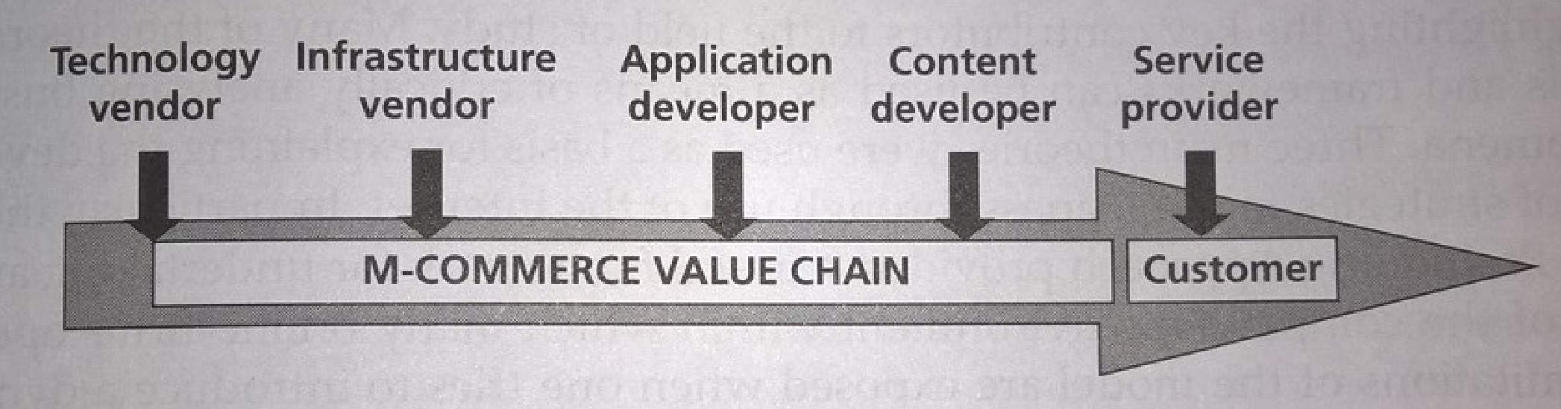
Mobile Commerce (Cont’d)
The mobile commerce value chain:
Strategies for m-commerce:
Many of the lessons learned in e-commerce can be transferred to that of m-commerce, especially strategic alliances and partnerships.
Strategic alliances create barriers to entry and extend the competencies of firms competing in the m-commerce domain.
Previously cited barriers to growth such as the lack of common standard, slow transmission, small screens and slow transaction times are being overcome.

Slide 63
Section Summary
Key learning points in this section:
Strategic management thinking has had to adapt to aid understanding of the role it plays in firms gaining and sustaining competitive advantage in the e-business domain.
The development of the digital economy has transformed businesses and the wider economy by providing new and better quality products and services that have global demand.
The Positioning Approach to strategy is a useful starting point for understanding competitive environments but does not translate well to e-business because of the static nature of the model and the lack of recognition that many modern e-business firms collaborate and establish partnerships.
The Resource-Based View recognizes the intangible resources and capabilities that form an important driver of competitive advantage in the e-business environment.

Slide 64
Section Summary (Cont’d)
Key learning points in this section (Cont’d):
Dynamic capabilities theory is an adjunct of the RBV designed to reflect the rapidly changing and uncertain environment that characterizes e-business.
M-commerce is highly reliant on strategic alliances and partnerships as individual firms seek to acquire the resources and capabilities needed to, first of all, compete effectively, and then go on to gain a competitive advantage.

